Slide 1
Deep Learning for Osteoporosis Detection: A Comparative Analysis of CNN vs. ResNet18 and ResNet50

Slide 2
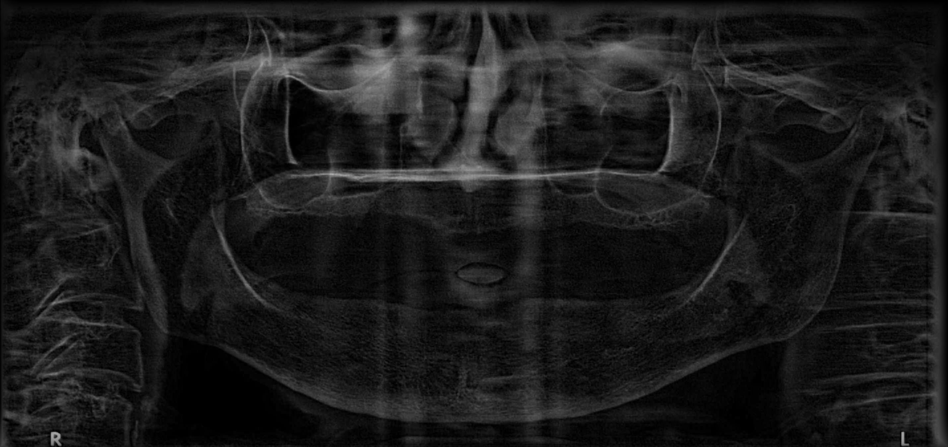
What is Osteoporosis?
Skeletal disorder characterized by compromised bone strength predisposing to an increased risk of fracture.
"Silent disease" - often asymptomatic until a fracture occurs.

Slide 3
Why is Early Detection Crucial?
Prevent fractures (hip, spine, wrist) and associated morbidity/mortality.
Enable timely intervention and treatment.
Current Diagnostic Methods:
DEXA (Dual-energy X-ray Absorptiometry) - gold standard (measures Bone Mineral Density - BMD).
X-rays (qualitative assessment of bone structure, sometimes indirect signs).
Role of AI in Medical Imaging:
Potential for faster, more accurate, and automated diagnosis.
Assist clinicians, especially in regions with limited specialist access.

Slide 4
What are Convolutional Neural Networks (CNNs)?
Specialized neural networks for image processing.
Learn hierarchical features (edges, textures, shapes, objects).
Why CNNs for Medical Images?
Excellent at pattern recognition in complex visual data.
Can extract subtle indicators of disease often missed by human eye or traditional methods.
The Problem of "Deep" Networks:
Vanishing/Exploding Gradients: Gradients become too small/large during backpropagation, hindering learning
in early layers.
Degradation Problem: As networks get deeper, performance can saturate and then degrade, not just due to
overfitting but due to difficulty in optimizing identity mappings.

Slide 5
Residual Networks (ResNets): Introduced by Microsoft Research (He et al., 2015).
Core Innovation: Residual Blocks (Skip Connections):
Instead of learning a direct mapping H(x), layers learn a residual function F(x)=H(x) − x.
The output becomes F(x) + x.
Visual: Show a simple diagram of a residual block with a bypass/shortcut connection.
Advantages of Residual Learning:
Mitigates Vanishing Gradients: Provides a direct path for gradients to flow.
Addresses Degradation Problem: Easier for deeper layers to learn identity mappings (if adding new layers provides no new information, F(x) can simply go to zero).
Enables Training of Very Deep Networks: Paved the way for networks with hundreds of layers.

Slide 6
Residual Networks (ResNet 18)
Architecture Overview:
Depth: 18 layers (convolutional and fully connected).
Building Block: Primarily uses Basic Blocks (two 3x3 convolutional layers with a skip connection).
Parameters: ~11.7 million parameters.
Key Characteristics:
Computational Efficiency: Faster training and inference times due to fewer layers and parameters.
Lower Memory Footprint: Requires less GPU memory.
Good Baseline: Often a strong starting point for many tasks, especially with smaller datasets.
Why choose ResNet18 for Osteoporosis?
Resource Constraints: Ideal for deployment on devices with limited computational power (e.g., edge devices, less powerful workstations in clinics).
Faster Prototyping/Experimentation: Quicker iteration cycles during research.
Smaller Datasets: Less prone to overfitting on smaller medical datasets compared to much larger models.

Slide 7
Residual Networks (ResNet 50)
Architecture Overview:
Depth: 50 layers.
Building Block: Primarily uses Bottleneck Blocks (1x1 conv -> 3x3 conv -> 1x1 conv with a skip connection).
Purpose of Bottleneck: Reduces dimensionality before the main 3x3 convolution and then expands it back.This reduces computational cost and parameters compared to using only basic blocks in a very deep network.
Parameters: ~25.6 million parameters (significantly more than ResNet18).
Key Characteristics:
Higher Representational Capacity: Can learn more intricate and abstract features due to its greater depth.
Generally Higher Accuracy: Often achieves superior performance on complex tasks and large, diverse datasets.
Why choose ResNet50 for Osteoporosis?
Capturing Subtle Patterns: Its depth allows it to learn more nuanced visual cues related to bone density, texture, and structural changes indicative of osteoporosis.
Large Datasets: When working with large-scale osteoporosis imaging datasets, ResNet50 can leverage the volume of data more effectively.
Maximizing Accuracy: If diagnostic accuracy is the absolute top priority, ResNet50 is often preferred.

Slide 8
Residual Networks (ResNets): Introduced by Microsoft Research (He et al., 2015).
Core Innovation: Residual Blocks (Skip Connections):
Instead of learning a direct mapping H(x), layers learn a residual function F(x)=H(x) − x.
The output becomes F(x) + x.
Visual: Show a simple diagram of a residual block with a bypass/shortcut connection.
Advantages of Residual Learning:
Mitigates Vanishing Gradients: Provides a direct path for gradients to flow.
Addresses Degradation Problem: Easier for deeper layers to learn identity mappings (if adding new layers provides no new information, F(x) can simply go to zero).
Enables Training of Very Deep Networks: Paved the way for networks with hundreds of layers.

